Slide 1
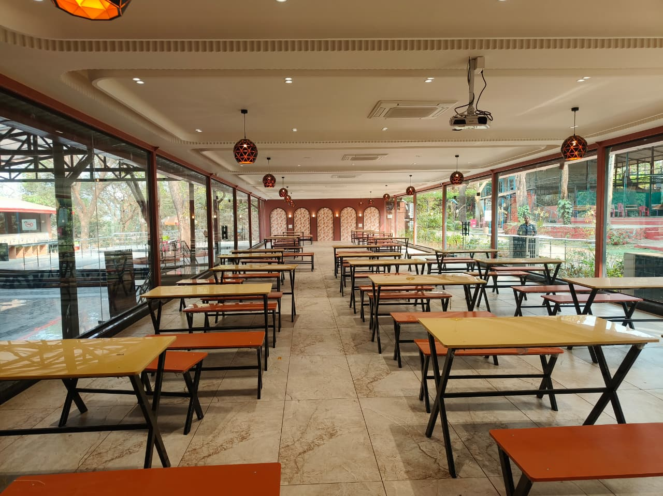

Food Fiesta
Primary Business Objectives
Upsell AC Banquet access
Group bookings & celebrations
Position AC Banquet as Premium Experience → Not just space, but comfort + exclusivity
Support Sales Team with Ready Leads + Walk-in Demand

Slide 2
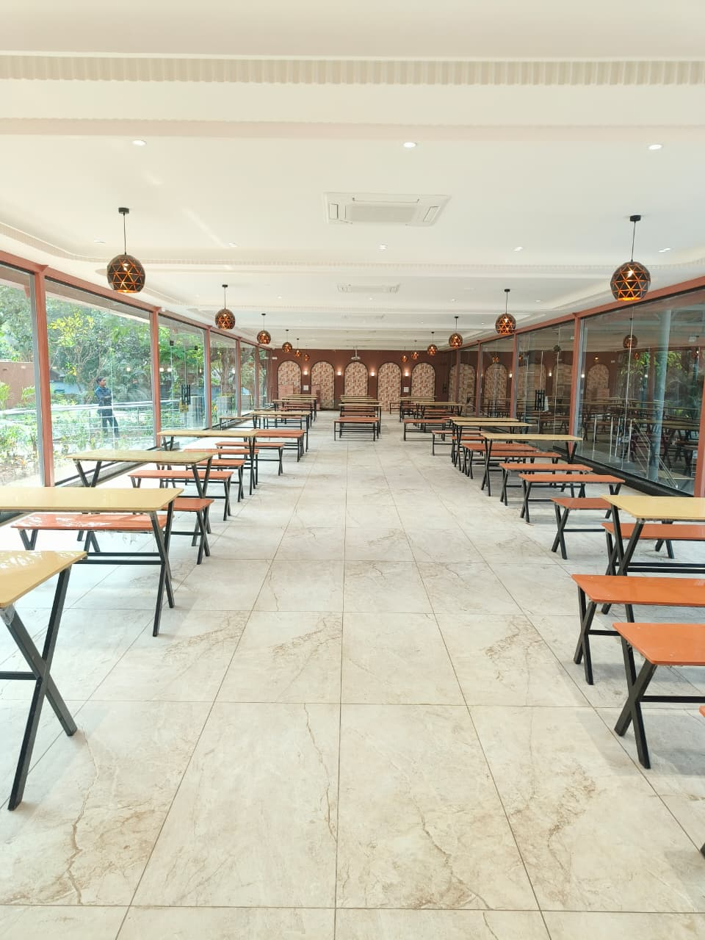
Target Audience Segmentation
Walk-in Park Visitors (B2C Upsell)
Groups & Celebrations (Lead Gen Focus)
Birthdays
Pre-wedding / Small wedding functions
Corporate team outings
Agents Meets
Product Launch
AGM
Marriage Anniversary
Reunion Parties
Kitty parties (very relevant to your earlier campaigns)
- Add standee ASAP at park

Slide 3
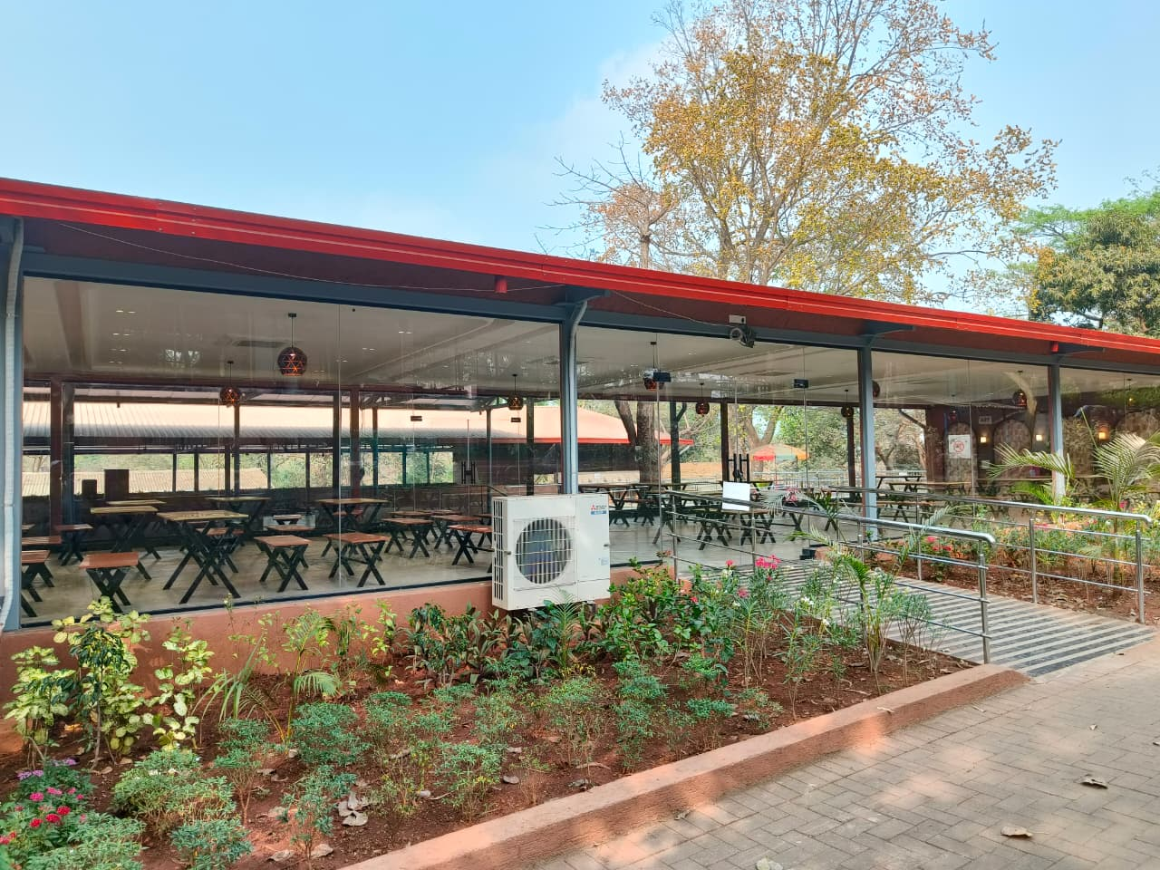
Digital Channel Strategy
META Ads & Google Ads – WALK-IN DEMAND CREATOR
Campaign Types
Experience Video Ads
Food + AC Comfort Visual Ads
Offer Based Ads
Creative Angles
“Escape Heat → Chill in AC Banquet”
“Upgrade Your Waterpark Day”
“Private Celebration Inside Waterpark”
Targeting
Parents with kids
Corporate job titles
Wedding / Event interest

Slide 4
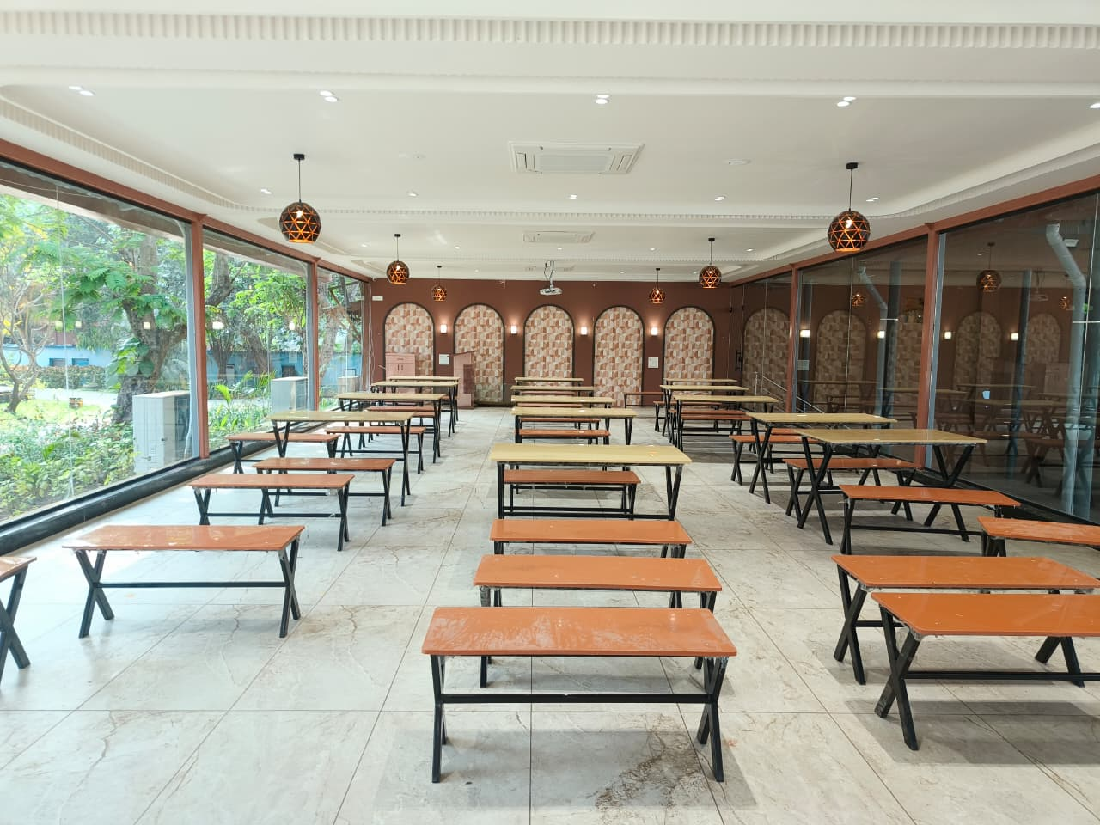
Remarketing Strategy (VERY IMPORTANT)
Retarget:
Website visitors
Ticket buyers
Food buyers
Past group database
Offer: “Upgrade Your Booking – AC Banquet Add-On”

Slide 5
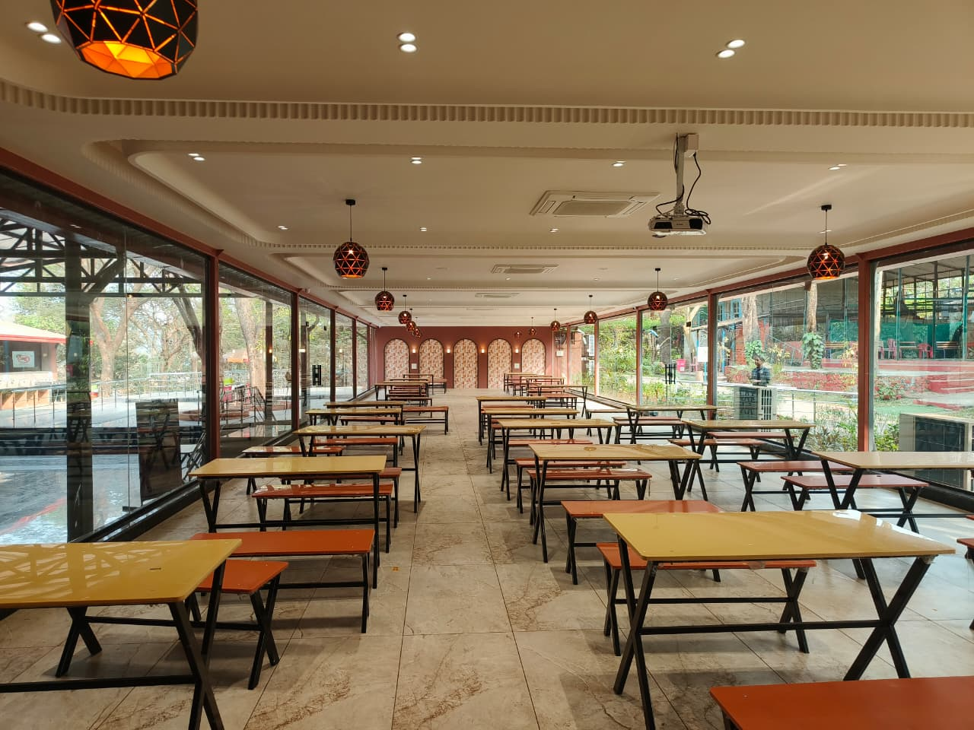
IN-PARK PROMOTION
Physical Branding
Entry Gate – “Upgrade Your Experience”
Food Court – AC Banquet Food Menu Display
Locker Area – Comfort Messaging
Wave Pool Queue – Standee’s
Discount Coupon – 20% off on Bday celebration – Amit
Standees across the park
Same Day booking – get one cake free

Slide 6
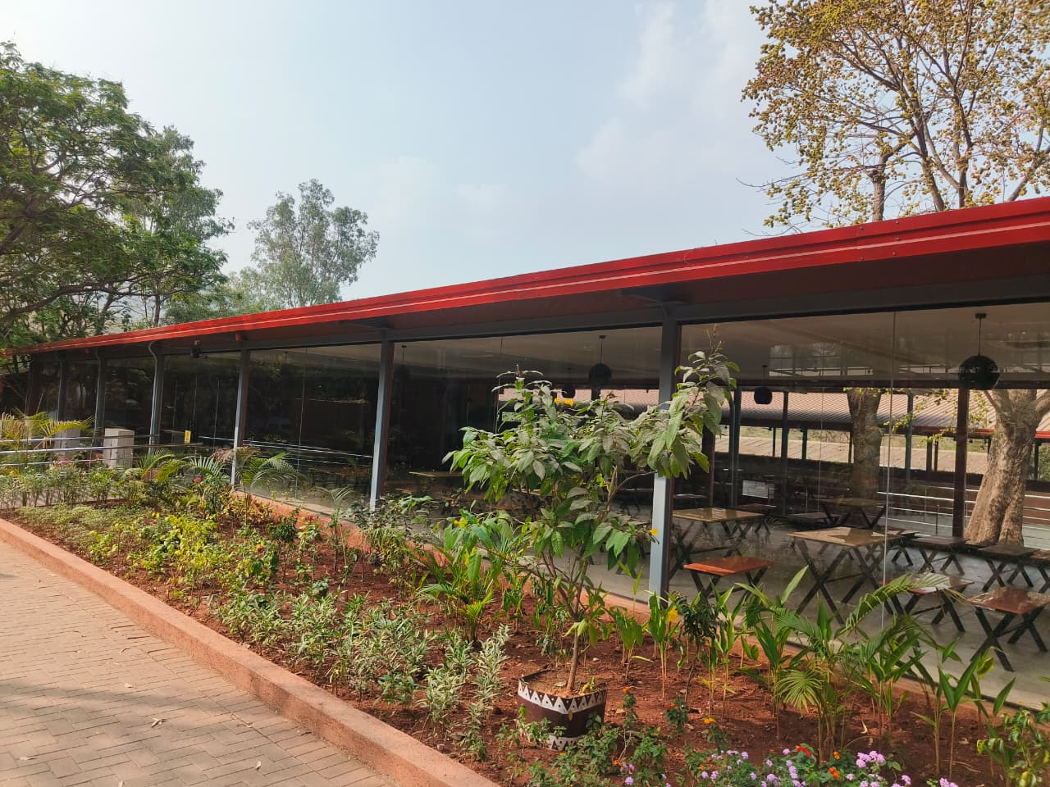
Content Strategy
Food closeups
AC comfort visuals
Celebration setups
Before vs After heat comparison
Scarcity Strategy “Only X slots per day”

Slide 7
Event Agent Tie-ups
Event Companies who celebrate all functions
End-to-End Solution – Bus, Snacks, Décor, DJ, Music & other engagement
Bus Engagement Activities – Mascots & Music
DJ & Anchor – Amit (booked for the day)

Slide 8
Pricing Details
• Price: 200/- above ticket per person
• Includes hall access, food & basic setup
• Premium yet value-for-money offering
Banquet Hall Overview
• Capacity: Up to 200 guests
• Fully Air-Conditioned Hall
• Separate & customizable food menu

Slide 9
Daywise Target & Rev Plan
 | Tuesday |  |  | Thursday |  |  | Saturday |  |  | Sunday
 | 2025 | 2026 | AC Banquet | 2025 | 2026 | AC Banquet | 2025 | 2026 | AC Banquet | 2025 | 2026 | AC Banquet | Total | Rev
April | 4013 | 4600 | 92 | 4570 | 6400 | 128 | 2916 | 3300 | 66 | 5715 | 5400 | 108 | 394 | 118200
May | 5112 | 9900 | 198 | 8975 | 12700 | 254 | 4701 | 7100 | 142 | 6705 | 15100 | 302 | 896 | 268800
June | 3708 | 6600 | 132 | 1569 | 6200 | 124 | 2348 | 3900 | 78 | 7677 | 8000 | 160 | 494 | 148200
Total | 12833 | 21100 | 4220 | 15114 | 25300 | 5060 | 9965 | 14300 | 2860 | 20097 | 28500 | 570 | 1784 | 535200

Slide 10
Revenue Projection – AC Banquet Hall
Monthly Booking Assumptions:
Groups per month: 8
Guests per groups: 100 – 150
Price per person: ₹1,200
Estimated Revenue:
8 Groups * 100 Guests * Rs.1200 = ₹9,60,000
10 Groups * 120 Guests * Rs.1200 = ₹14,40,000
12 Groups * 150 Guests * Rs.1200 = ₹21,60,000

Slide 11
Food Menu – This is final one refer
Welcome Refreshments
Welcome Drink (Lemon juice) – Rs.3
Fafda with Kadhi – ??
Lunch
Tomato Cream Soup or HotnSour Soup – Rs. 12
Complimentary
1 Water Bottle - Rs. 8
AC & Elec. – Rs. 7000/day

Slide 12
Target Audience
• Corporate clients (Meetings, Team outings, AGMs) - 15
• Schools & Institutions - 10
• Social events (Birthdays, Engagements) - 10
• Associations / Samaj / Societies - 10
Business Growth Plan
Reach 20 Event Management Companies (Andheri to Virar)
Approach 50 Corporate & Groups Clients for meetings, outings & celebrations
Direct corporate & agent tie-ups

Slide 13
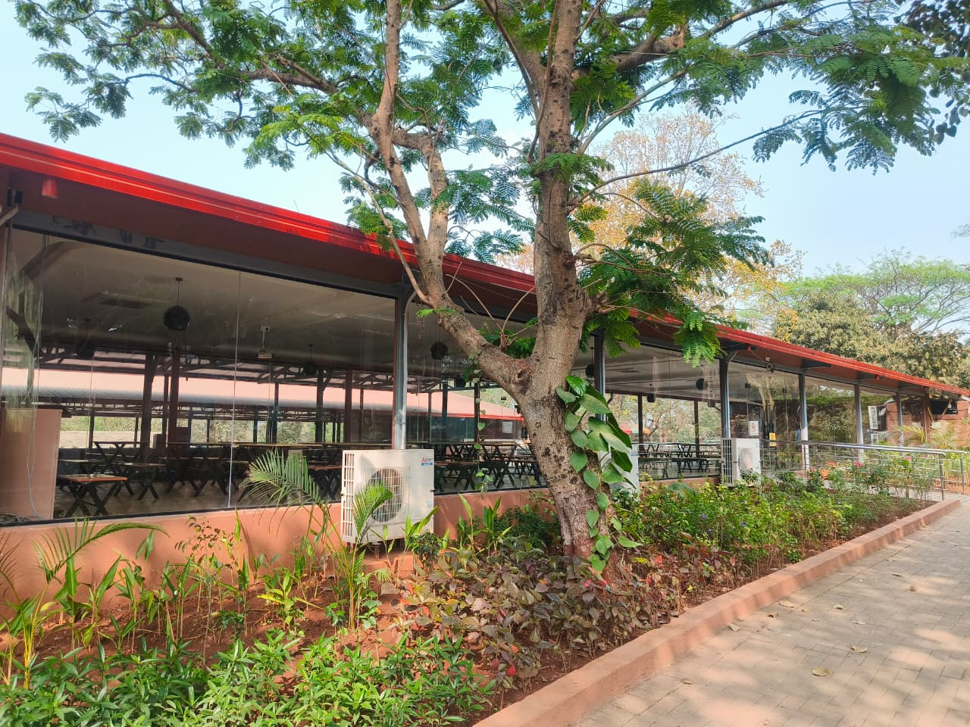
Thank You

Slide 15
Food Menu
Welcome Refreshments
Welcome Drink (Lemon juice)
Fafda with Kadhi & Sambharo, Jalebi
Lunch
Tomato Cream Soup or HotnSour Soup
Cheese corn-ball (Theeka Meetha chutney)
Umbadiyu
Evening
Raj Kachori
Complimentary
1 Water Bottle, 1 Pop-corn (give one coupon), Unlimited Wifi, 1 vanilla Ice cream (give one coupon)

Slide 16
Budget vs Conversion Plan
Channel | Platform | Amount | Impressions | CTR | Clicks | CRO | Conv Count | Price | Revenue
Online | Meta | 50000 | 2500000 | 2.15% | 53750 | 1% | 538 | 500 | 268750
Online | Google | 50000 | 300000 | 15.64% | 46920 | 1% | 469 | 500 | 234600
Offline | In-park | 20000 | - | - | - | - | 100 | 500 | 50000
Total |  | 120000 | 2800000 | 17.79% | 100670 | 2% | 1107 | 500 | 553350

